Slide 1

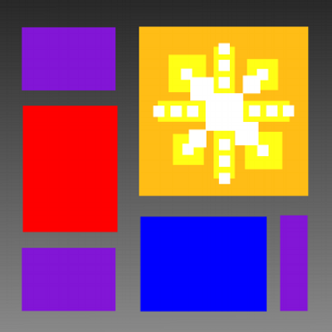


Functional programming: a jump start for C# devs
Philippine .NET UG
Twitter @bryan_hunter @PHINUG
@fireflylogic
#fsharp #NashFP or #ManilaFP
presented by Bryan Hunter CTO Firefly Logic

Slide 2
?

Slide 3






Slide 4
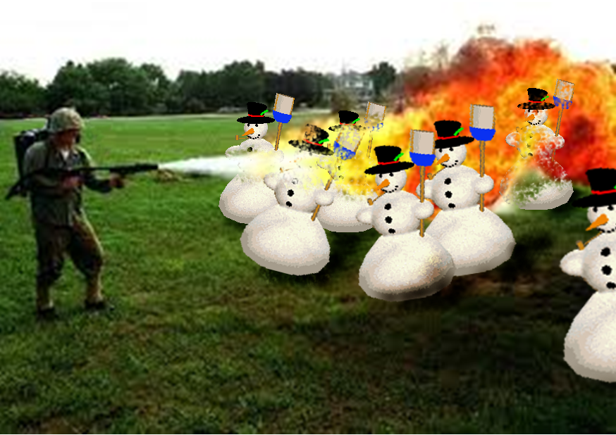
Right tool for the job!

Slide 5
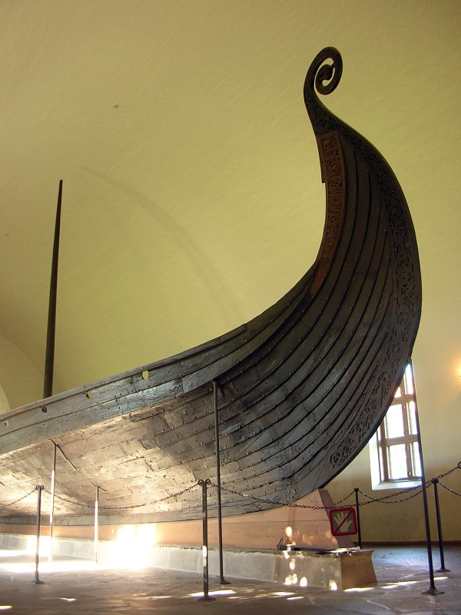
Norway
2007
6 weeks
20,000,000 LOC
12 architects
1 big mess
5 minute chat
4 years
0 seconds downtime
Life changed

Slide 6

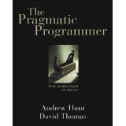
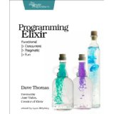


“Programmers not on board with functional programming in 5 years will be maintenance programmers.”
- Dave Thomas @pragdave GOTO Chicago 2014

Slide 7
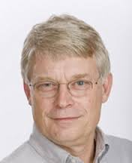
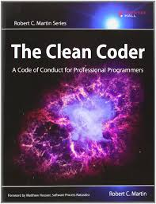
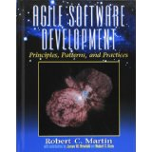
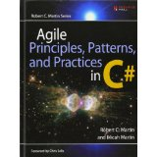
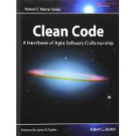
“The ‘When’ is pretty much now.”
-Robert Martin “Functional Programming What? Why? When?” NDC London 2013

Slide 8
Multicore
Concurrency
Distributed Computing
Software Complexity
FP Success Stories
Higher Stakes

Slide 9
Princeton University 1930s
Languages
Imperative
Procedural
OO
Declarative
Functional
Data flow
Logic

Slide 10
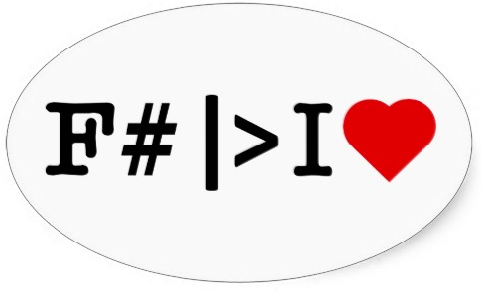
Notes:
http://www.zazzle.co.uk/consideredharmful

Slide 11
A Slide of Scary Terms
Referential Transparency
Immutability
Recursion
Higher Order Functions
Pattern Matching
Code as Data
Separation of Data from Behavior

Slide 12
Referential Transparency

Slide 13
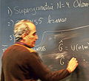
Referential Transparency
f(x,y)=x+y
Notes:
http://commons.wikimedia.org/wiki/File:Witten_Blackboard.jpg

Slide 14
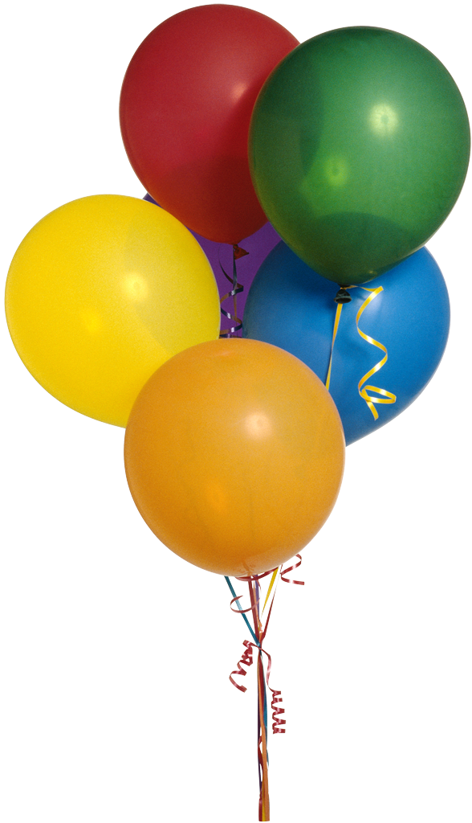

Referential Transparency
f(x,y)=x+y
Notes:
http://commons.wikimedia.org/wiki/File:Witten_Blackboard.jpg

Slide 15
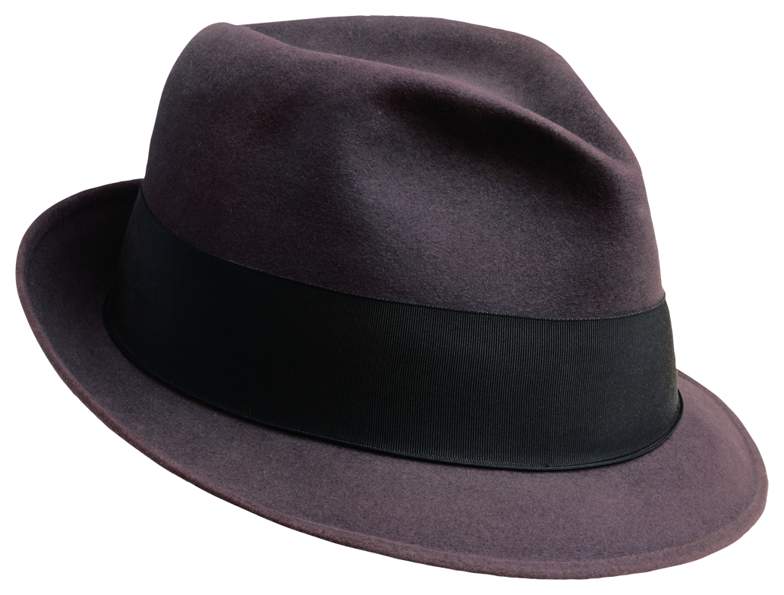
Referential Transparency
f(x,y)=x+y
f(x,y)=x+y

Slide 16
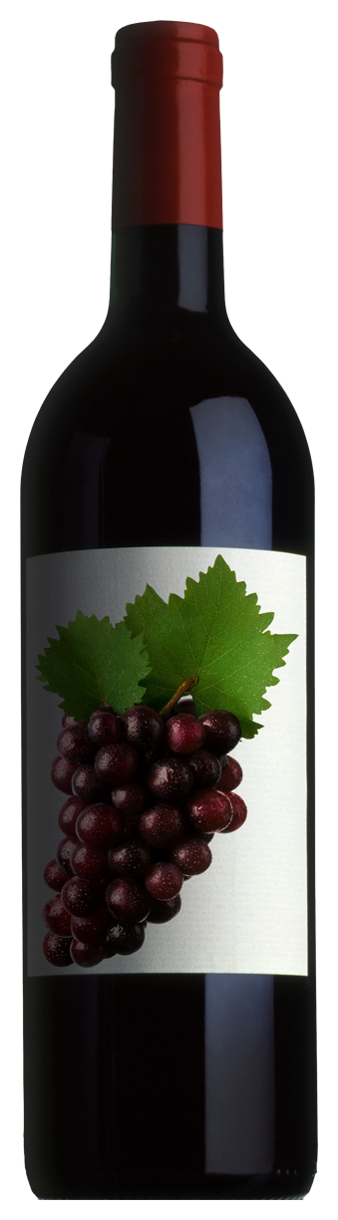
Referential Transparency
f(x,y)=x+y
f(x,b)=x-b

Slide 17
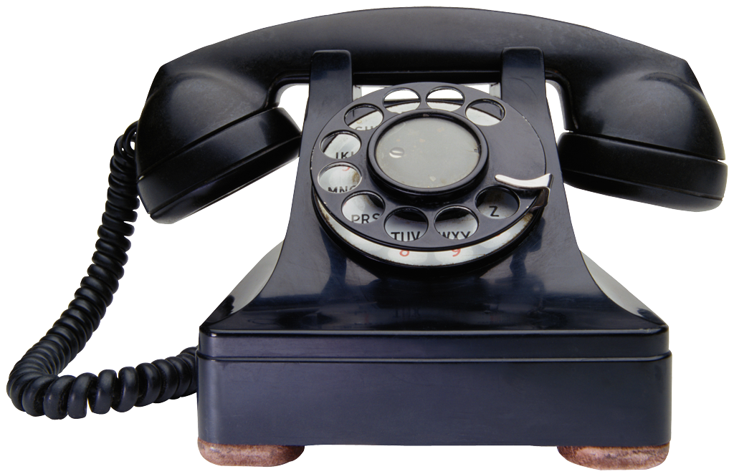
Referential Transparency
f(x,y)=x+y
f(x,b)=x-b

Slide 18

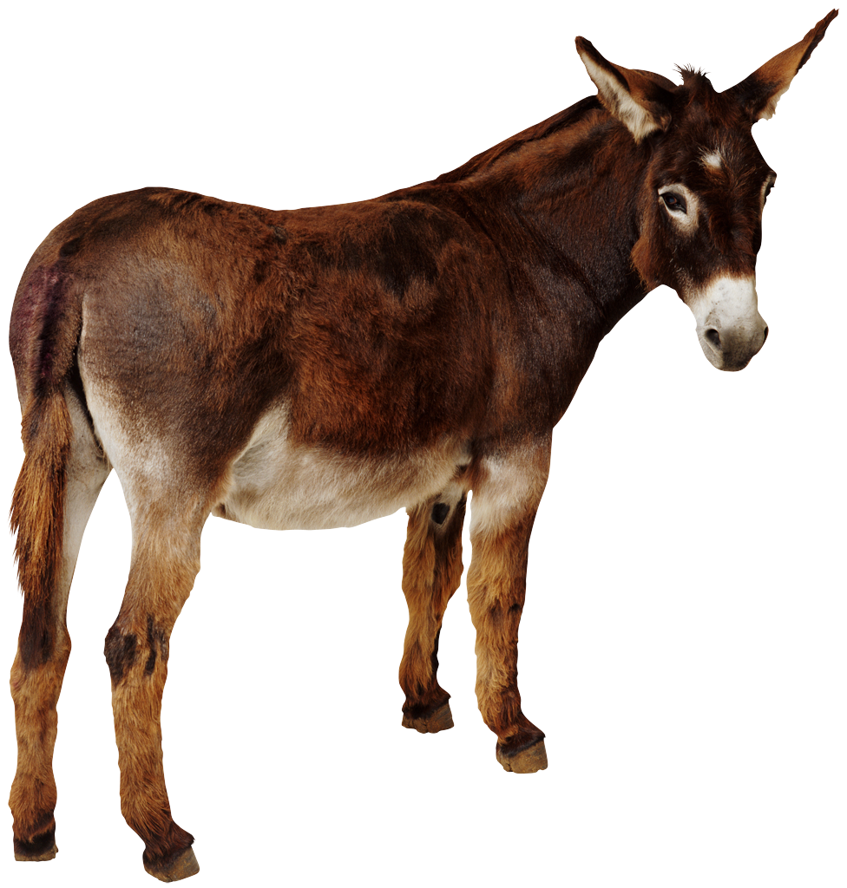
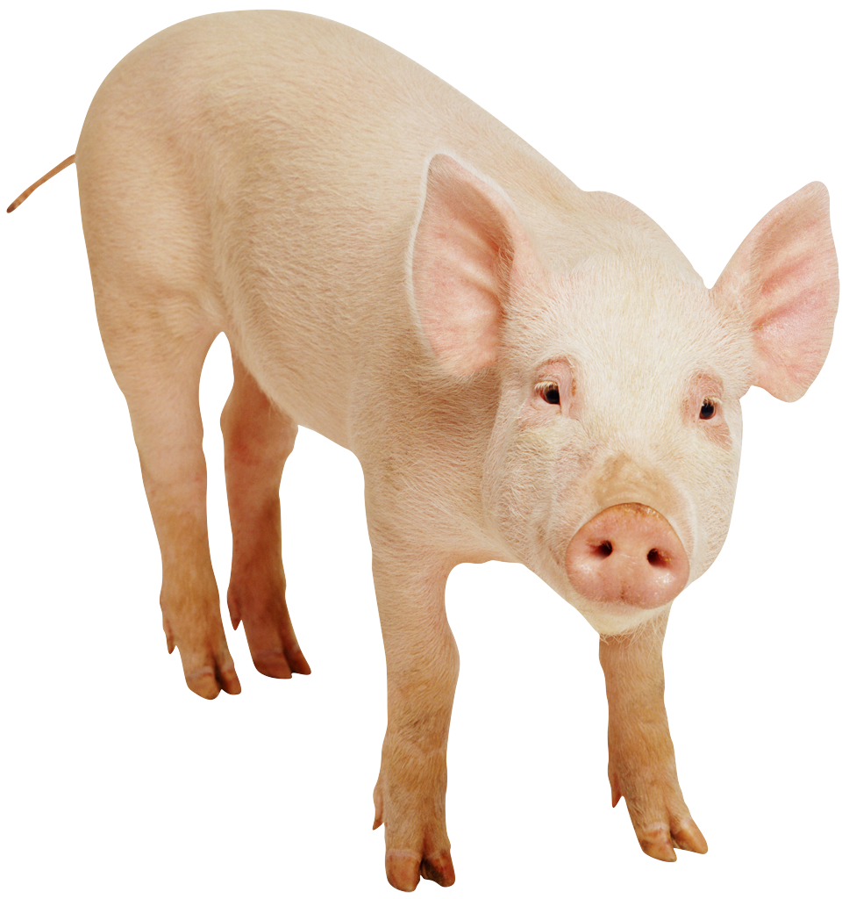
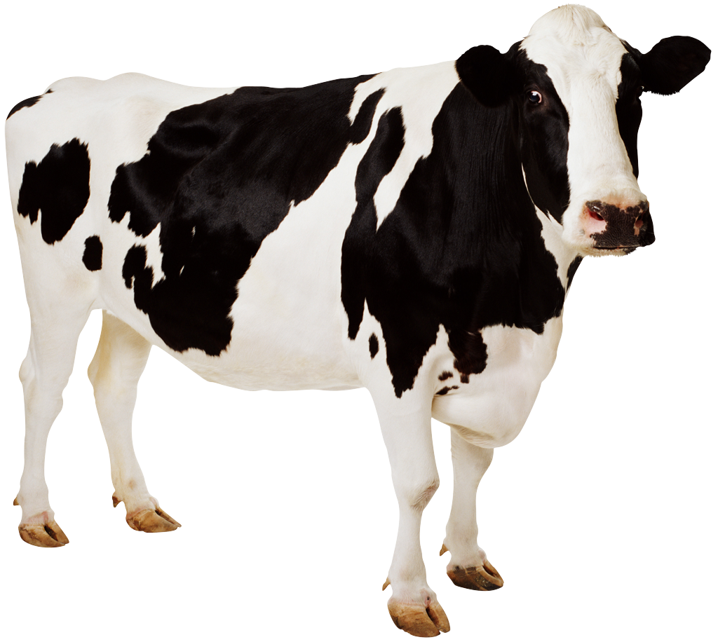
Referential Transparency
f(x,y)=x+y
f(x,b)=x-b

Slide 19
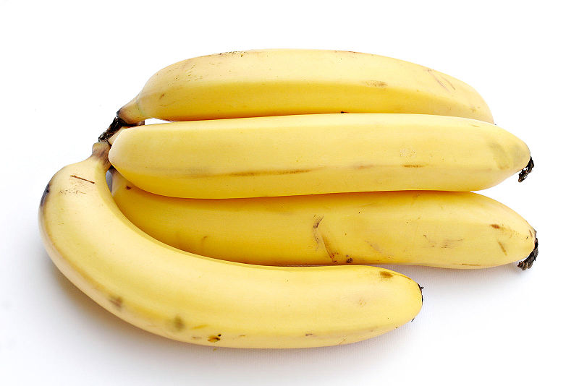
Notes:
http://commons.wikimedia.org/wiki/File:Bananas_white_background.jpg

Slide 20
Immutability

Slide 21
CompSci 101 X = X + 1
Increment!
High school math X = X + 1
“F” You fail!

Slide 22
Immutability
F# Interactive for F# 3.1
>

Slide 23
Immutability
F# Interactive for F# 3.1
> let x = 5;;

Slide 24
Immutability
F# Interactive for F# 3.1
> let x = 5;;
val x : int = 5
>

Slide 25
Immutability
F# Interactive for F# 3.1
> let x = 5;;
val x : int = 5
> x = x + 1;;

Slide 26
Immutability
F# Interactive for F# 3.1
> let x = 5;;
val x : int = 5
> x = x + 1;;
val it : bool = false
>

Slide 27
Immutability
F# Interactive for F# 3.1
> let x = 5;;
val x : int = 5
> x = x + 1;;
val it : bool = false
> x <- 7;;

Slide 28
Immutability
F# Interactive for F# 3.1
> let x = 5;;
val x : int = 5
> x = x + 1;;
val it : bool = false
> x <- 7;;
x <- 7;;
^^^^^^
//stdin(19,1): error FS0027: This value is not mutable
>

Slide 29
Imperative Languages mutate state Functional Languages transform inputs into outputs

Slide 30
Immutability
f(x) = x + 1

Slide 31
Immutability
f(x) = x + 1 f(5) = 5 + 1

Slide 32
Immutability
How about line of business?
Domain objects?

Slide 33
Immutability
public class Employee { private readonly string _name; private readonly DateTime _hireDate; public Employee(string name, DateTime hireDate) { _name = name; _hireDate = hireDate; } public string Name{ get { return _name;} } public DateTime HireDate { get { return _hireDate;} } }
C#

Slide 34
Immutability
public class Employee { private readonly string _name; private readonly DateTime _hireDate; public Employee(string name, DateTime hireDate) { _name = name; _hireDate = hireDate; } public string Name{ get { return _name;} } public DateTime HireDate { get { return _hireDate;} } }
C#
type Employee = {Name:string; HireDate:System.DateTime}
F#

Slide 35
Recursion

Slide 36
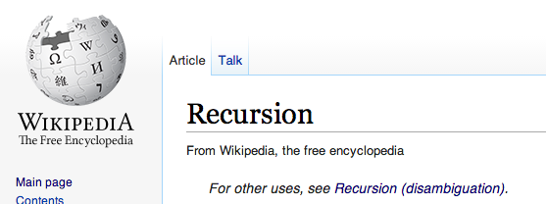

Slide 37
loops vs recursion

Slide 38
Higher Order Functions

Slide 39
A function is a higher order function
if
it takes one or more functions as input arguments
or
it returns a function as its return value

Slide 40
Higher Order Functions
// If you know LINQ you know higher order functions
IEnumerable<Person> people = GetThePeeps(); Func<Person,bool> isMale = x => x.Sex == "M"; var maleNames = people.Where (isMale) .Select (x => x.FirstName) .ToList();
C#

Slide 41
public void HiFuns(string country) { IEnumerable<Person> people = new List<Person>(); Func<Person, string> namer = GetNamer(country); var names = people .Select (x => namer(x)).ToList(); } Func<Person,string> GetNamer(string country) { Func<Person,string> defaultNamer = (p) => p.FirstName; Func<Person,string> tagalogNamer = (p) => { if (p.Age > 42 && p.Sex == ”M") return "Mang " + p.FirstName; else if (p.Age > 50 && p.Sex == "F") return "Aling " + p.FirstName; else return p.FirstName; }; return (country == "Philippines") ? tagalogNamer : defaultNamer; }
C#

Slide 42
Pattern Matching

Slide 43
Pattern Matching (F# constant pattern ≈ C# case statement)
type Color = | Red = 0 | Green = 1 | Blue = 2
let printColorName (color:Color) = match color with | Color.Red -> printfn "Red" | Color.Green -> printfn "Green" | Color.Blue -> printfn "Blue" | _ -> ()
F#

Slide 44
Pattern Matching (Identifier Patterns)
type PersonName = | FirstOnly of string | LastOnly of string | FirstLast of string * string
let constructGreeting personName = match personName with | FirstOnly first -> printf "Hi %s" first | LastOnly last -> printf "Yo, %s" last | FirstLast(first, last) -> printf "Hey %s %s" first last
F#

Slide 45

Pattern Matching (active pattern)
// setup the active patterns let (|MultOf3_|) i = if i % 3 = 0 then Some MultOf3 else None let (|MultOf5_|) i = if i % 5 = 0 then Some MultOf5 else None // the main function let fizzBuzz i = match i with | MultOf3 & MultOf5 -> printf "FizzBuzz, " | MultOf3 -> printf "Fizz, " | MultOf5 -> printf "Buzz, " | _ -> printf "%i, " i
// Test
[1..20] |> List.iter fizzBuzz
F#
Thanks to Scott Wlaschin “F# for Fun and Profit”

Slide 46
Code as Data

Slide 47
Separation of Data from Behavior

Slide 48
“Learning FP will make you a better OO developer.”

Slide 49
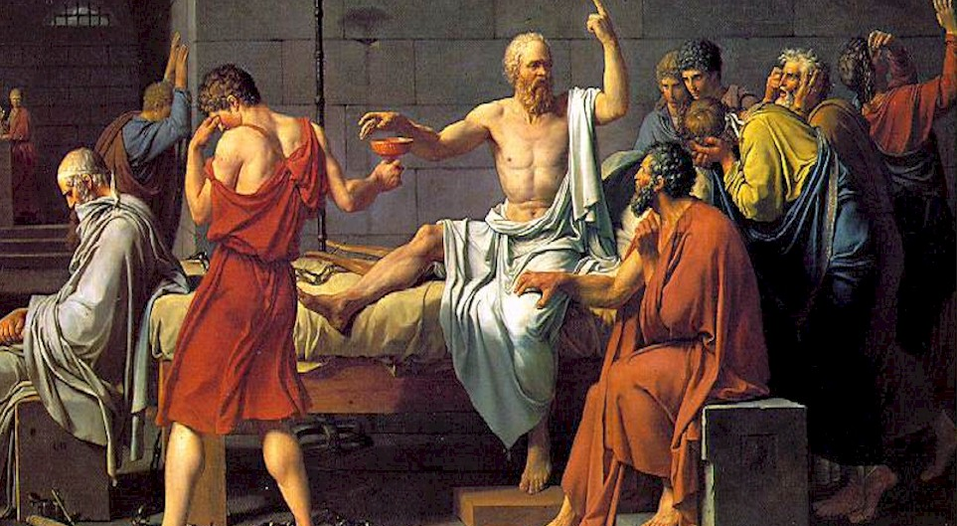
FP and Ethics

Slide 50

http://nashfp.org

Slide 51




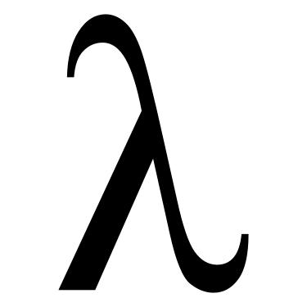

Polyglot FP

Slide 52
Active vs. Passive Learning
No one left behind
Show-and-Tell
Dojos
Labs
No slides
Constant chatter

Slide 53
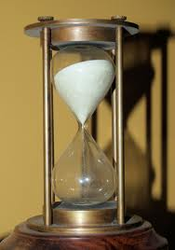
Three Hours

Slide 54


Slide 55
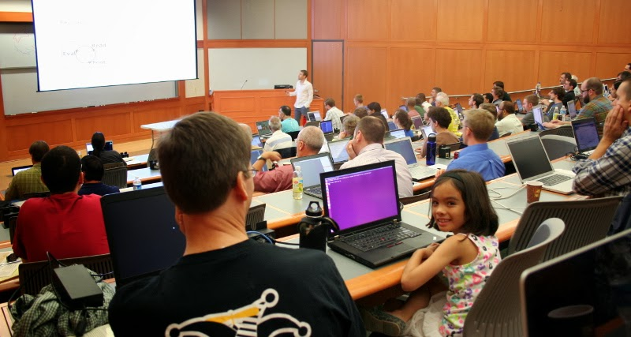
A Safe Place

Slide 56
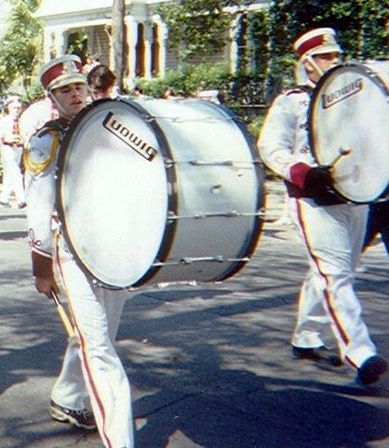


Cheering

Slide 57
ManilaFP?

Slide 58
Thanks!
Bryan Hunter
Twitter: @bryan_hunter
Email: bryan.hunter@fireflylogic.com Skype: huntercb
Firefly Logic, Inc.
1000 Main Street #201 Nashville, TN 37206
http://fireflylogic.com
> keep in touch

